Slide 1
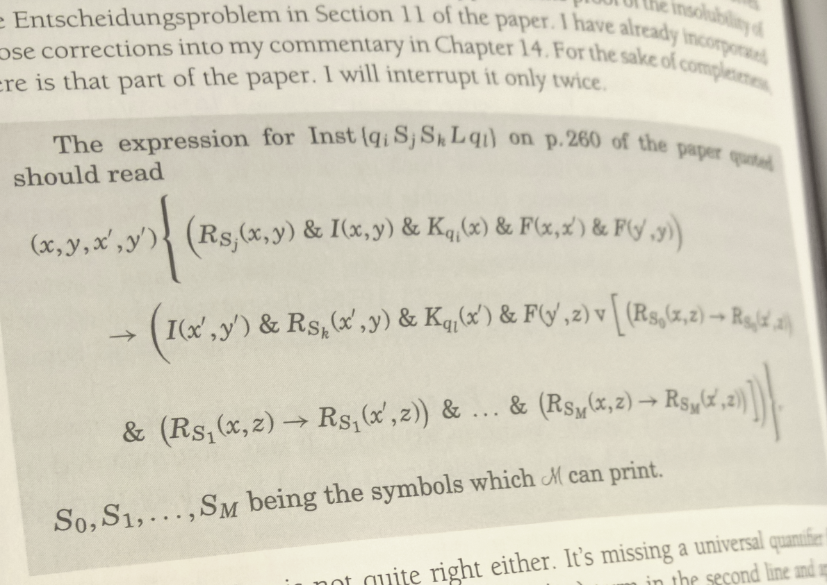
3 Mathematical Concepts Every Developer Should Know
Michael L Perry
@MichaelLPerry
michael@qedcode.com

Slide 2





































TITANIUM SPONSORS
Platinum Sponsors
Gold Sponsors

Slide 3

pluralsight.com/live

Slide 4
3 Mathematical Concepts Every Developer Should Know
Michael L Perry
@MichaelLPerry
michael@qedcode.com

Slide 5
Math is Useful For
Machine Learning
Games
…
¯\_(ツ)_/¯
All Software

Slide 6
3 Mathematical Concepts Every Developer Should Know
Michael L Perry
@MichaelLPerry
michael@qedcode.com

Slide 7
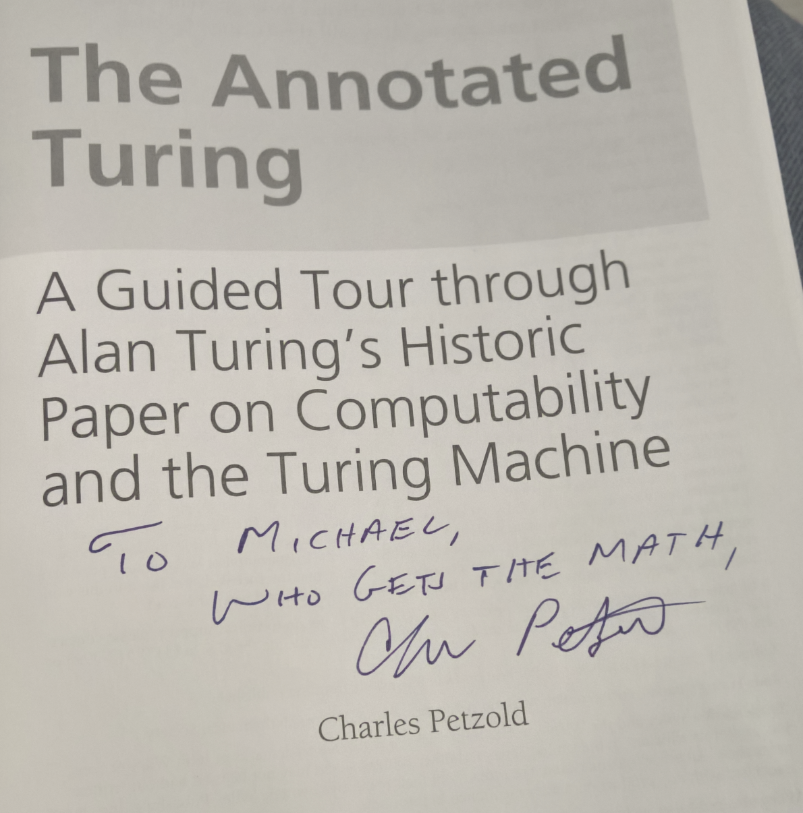
Signed by the Author!

Slide 8
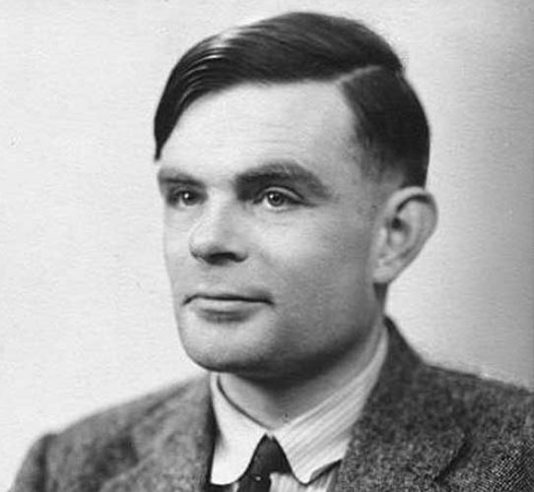
Alan Turing (1912-1954)

Slide 9
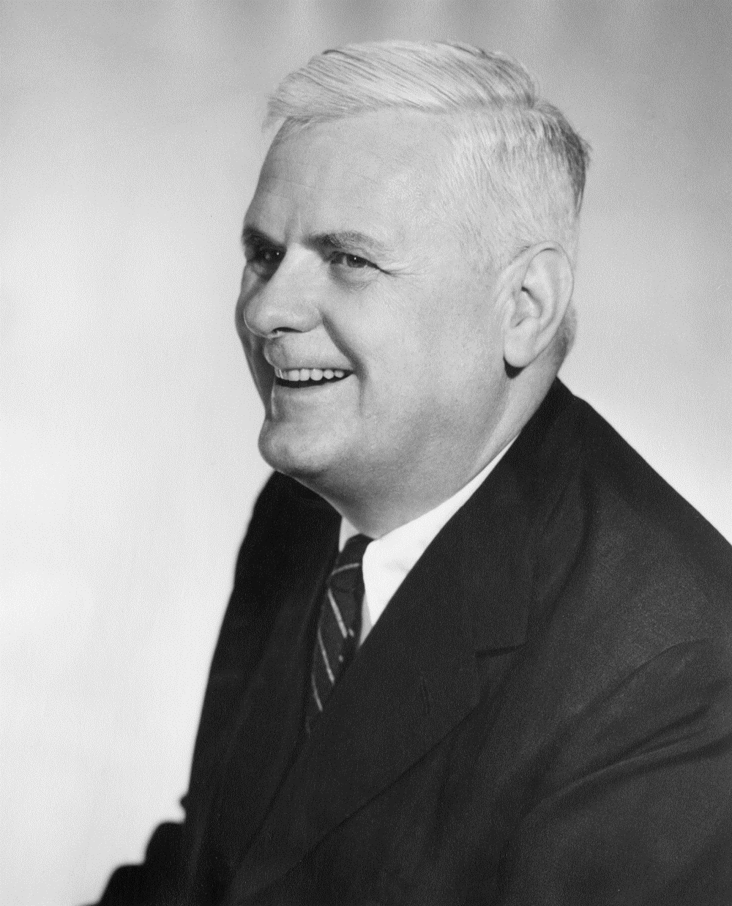
Alonzo Church (1903-1995)

Slide 10
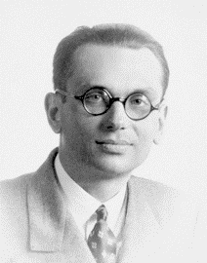
Kurt Gödel (1906-1978)

Slide 11
Completeness
Axioms
Theorems
0 is a natural number
If x is a natural number, then x+1 is a natural number
a + (b+1) = (a+1) + b
a+b = b+a
a+0 = a
Can all theorems be proved within the system?

Slide 12
Kurt Gödel 1931
No

Slide 13



Entscheidungsproblem
Truth
Satisfiability
Validity
$$3^{2}+4^{2}=5^{2}$$
$$a^{2}+b^{2}=c^{2}$$
$$a+b=b+a$$
Is there always a way to determine whether a statement is valid?

Slide 14
Kurt Gödel 1931
1936
No

Slide 15
Predicate Calculus
Preposition (0th-order)
Predicate (1st-order)
Predicate (higher-order)
Radar is a dog
If x is a dog, then x is a mammal
(If x is an A, then x is a B) implies (if x is not a B, then x is not an A)

Slide 16
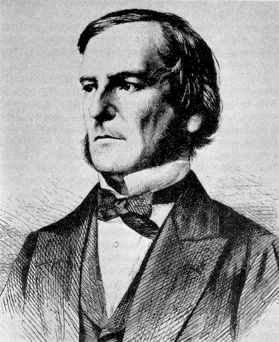
George Boole (1815-1864)

Slide 17
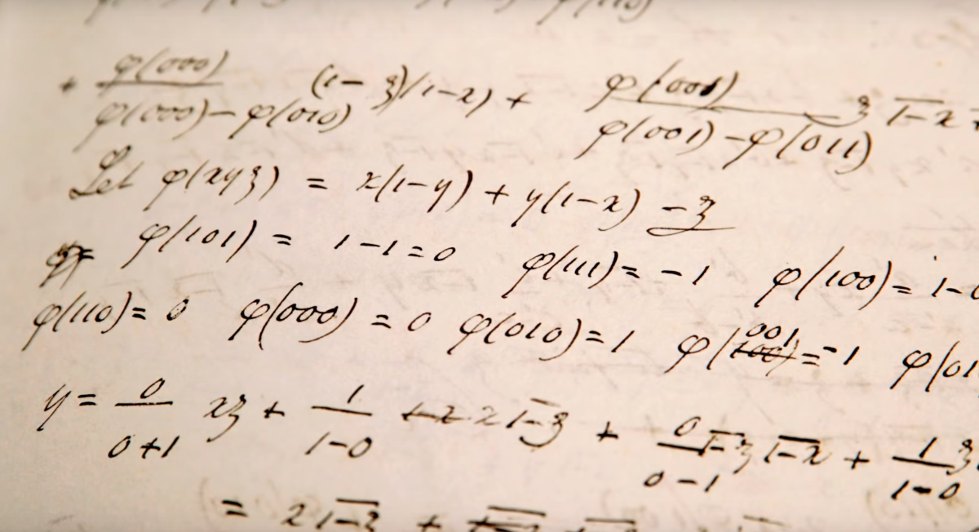
Boolean Algebra

Slide 18
if (page.RequiresAdministrator && user.IsAdministrator)
{
return true;
}
if (page.RequiresSuperUser && (user.IsAdministrator || user.CanWrite))
{
return true;
}
if (user.IsAdministrator || user.CanWrite || user.CanRead)
{
return true;
}
return false;

Slide 19
if (user.IsAdministrator)
{
return true;
}
if (page.RequiresSuperUser && user.CanWrite)
{
return true;
}
if (user.CanWrite || user.CanRead)
{
return true;
}
return false;
Axiom
If a user can write, then the user can read

Slide 20
if (user.IsAdministrator)
{
return true;
}
if (page.RequiresSuperUser && user.CanWrite)
{
return true;
}
if (user.CanRead)
{
return true;
}
return false;

Slide 21
private void CheckInvariants()
{
VerifyIfThen(CanWrite, CanRead,
"if the user can write then the user can read");
}
private void VerifyIfThen(bool condition, bool inference,
string invariant)
{
if (condition == true && inference == false)
{
throw new InvalidOperationException(
$"Invariant vioated: {invariant}.");
}
}

Slide 22
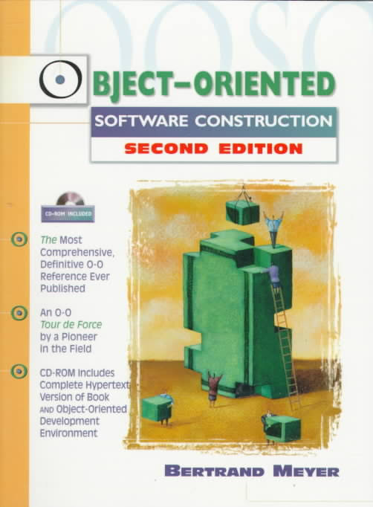
Bertrand Meyer, Object Oriented Software Construction
Preconditions
Postconditions
Invariants

Slide 23
Unit Tests
Truth
Satisfiability
Validity
$$3^{2}+4^{2}=5^{2}$$
$$a^{2}+b^{2}=c^{2}$$
$$a+b=b+a$$

Slide 24
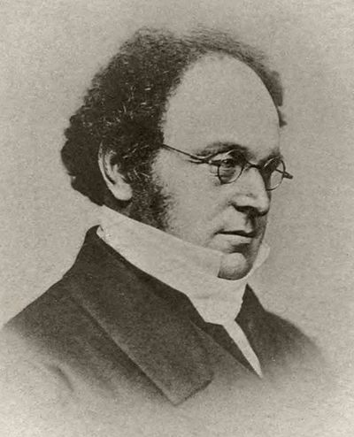
Augustus De Morgan (1806-1871)

Slide 25
De Morgan’s Theorems
Not (A or B) = Not A and Not B
Not (A and B) = Not A or Not B

Slide 26
if (!(page.IsReadOnly || user.CanWrite))
{
throw new Exception("Not authorized");
}
if (!page.IsReadOnly && !user.CanWrite)
{
throw new Exception("Not authorized");
}

Slide 27
Quantifiers
Existential
Universal
There exists a thing x such that P(x) is true
For all things x, P(x) is true
There does not exists x such that P(x) is true =
For all x, P(x) is false
Not for all x is P(x) true =
There exists an x such that P(x) is false

Slide 28
Requirements
An administrator can always write
If a user can write, then the user can read
If for a customer, there exists an order such that the order total is greater than $50K, then the customer is preferred

Slide 29

21 Jewel Movement
How many degrees of freedom?

Slide 30
21 Jewel Movement
How many connections between gears?

Slide 31
Degrees of Freedom
Number of variables minus number of constraints
21 – 20 = 1

Slide 32
Decision Tree
Expected Value = ∑(Probability * Value) - Cost
60%
Success
Yes
Be informed about market
$50K
40%
Failure
$3K
$0K
Should we do the market research?
30%
Success
No
Be uninformed about market
$50K
$0K
70%
Failure
$0K

Slide 33
Degrees of Freedom
6
Variables
Constraints
10
4
Value of Success
Value of Failure
Probability (x4)
Expected Value (x2)
Cost of Research
Cost of No Research
Total Probability is 100% (x2)
Expected Value = ∑(Probability * Value) – Cost (x2)

Slide 34
Kinds of Variables
Independent Variables
Dependent Variables
6
Value of Success
Value of Failure
Probability of Success (x2)
Cost of Research
Cost of No Research
Probability of Failure (x2)
Expected Value (x2)

Slide 35
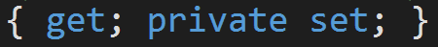
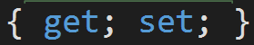
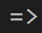
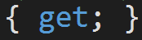
Three Kinds of State
Independent
Can change without affecting other independent variables
Represented by fields
Dependent
Calculated based on other variables
Represented by expression-bodied properties and pure functions
Immutable
Can’t change
Represented by read only fields
Initialized by constructor

Slide 36
Decision Tree
Expected Value = ∑(Probability * Value) - Cost
60%
Success
Yes
Be informed about market
$50K
40%
Failure
$3K
$0K
Should we do the market research?
30%
Success
No
Be uninformed about market
$50K
$0K
70%
Failure
$0K

Slide 37

Node
1
Path
Root
ChoiceNode expectedValue
*
Option cost
=
ProbabilityNode expectedValue
*
Chance weight
=
OutcomeNode expectedValue

Slide 38

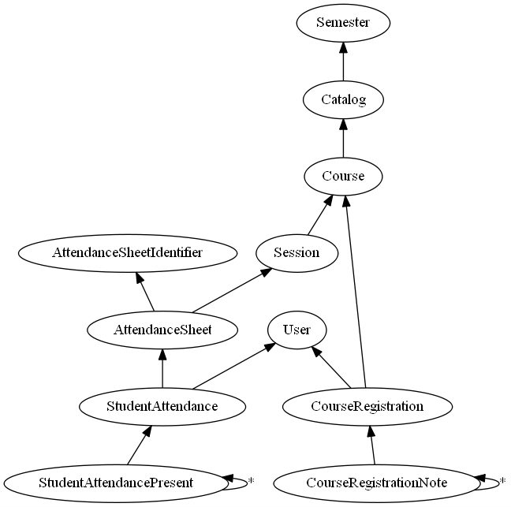
graphviz.org
digraph "Attendance" {
rankdir = BT
Catalog -> Semester
Course -> Catalog
CourseRegistration -> { User, Course }
CourseRegistrationNote -> CourseRegistration
CourseRegistrationNote -> CourseRegistrationNote [label="*"]
Session -> Course
AttendanceSheet -> { AttendanceSheetIdentifier, Session }
StudentAttendance -> { User, AttendanceSheet }
StudentAttendancePresent -> StudentAttendance
StudentAttendancePresent -> StudentAttendancePresent [ label="*" ]
}

Slide 39
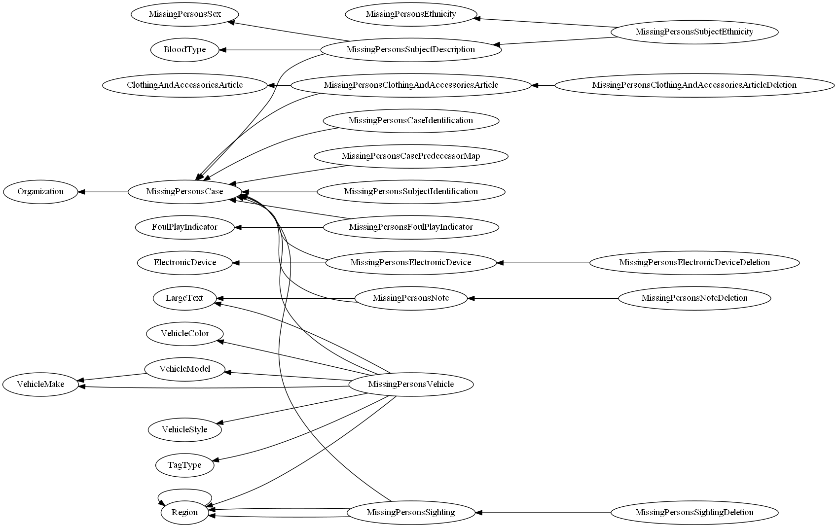
Entity Relationships

Slide 40
Concurrency
Any two vertices that have no path from one to the other
A
B and C are concurrent
C
B
Opportunity for parallelism
Chance of introducing a Cartesian product
D

Slide 41
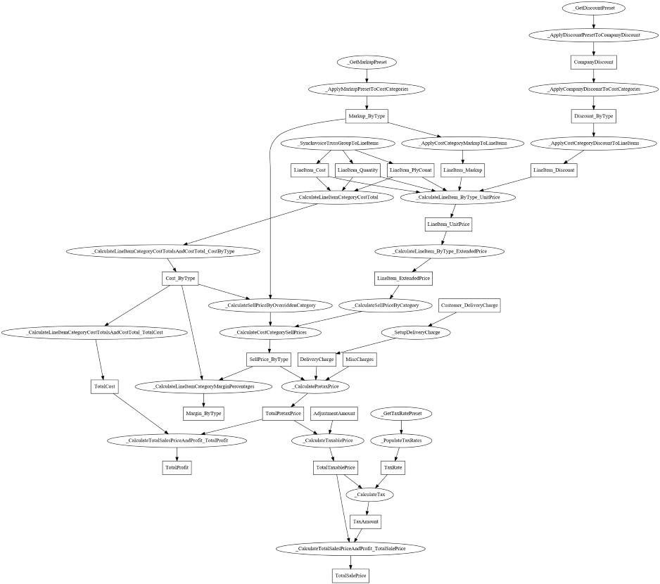
Calculations

Slide 43
Calculations

Slide 44
Topological Order
Any sequence of the nodes such that the tail of each edge appears before the head
A
D
B
C
A
D
C
B
A
C
B
D

Slide 45
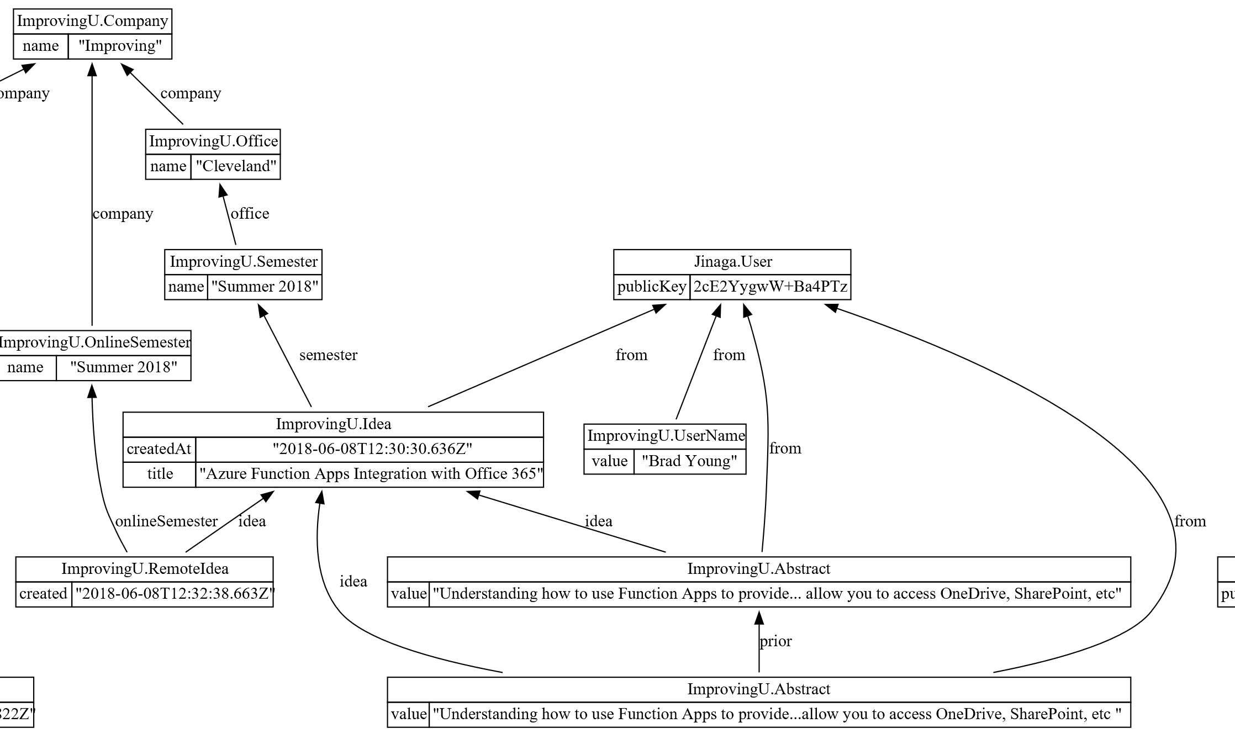
Historical Facts

Slide 48
Historical Facts

Slide 49
Cycles
A directed graph with no cycles is a Directed Acyclic Graph (DAG)
A
Has a topological order
Is constructible by repeatedly adding immutable vertices
C
B
D

Slide 50
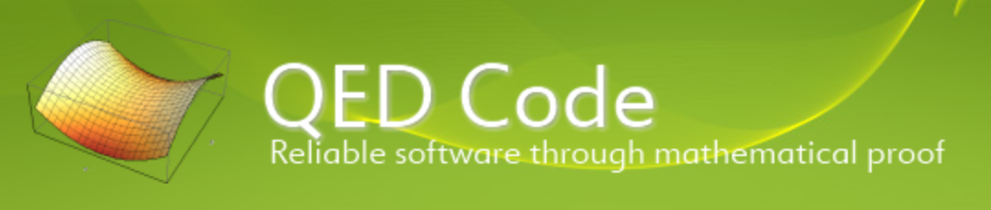
3 Mathematical Concepts Every Developer Should Know
Predicate Calculus
Ernest Nagel, Gödel's Proof
Charles Petzold, The Annotated Turing
Bertrand Meyer, OOSC
Degrees of Freedom
Assisticant
Directed Graphs
Graphviz.org
Michael L Perry
@MichaelLPerry
michael@qedcode.com

